Slide 1
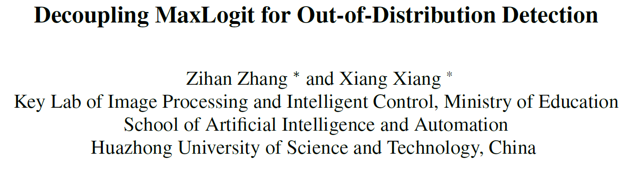
Published in 2023 CVPR
Mingle Xu
Jeonbuk National University
2023 Sep 8

Slide 2
Motivation to share this paper
Robustness of trained models
Open set and domain shift
Understanding the features extracted by learning models.
Analyzing the features, instead of the logit or probabilities – Dong Sun Park.
Analyzing the low-level features – Dong Sun Park.
How to find a research topic and challenge. Analyze them and do something beneficial to the community.

Slide 3
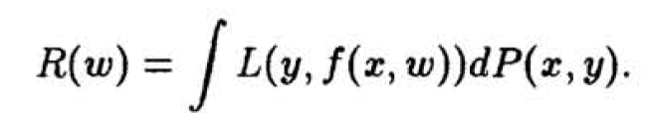
Background: empirical risk minimization (ERM)
How to train a network? What kind of loss and data do we want and can use.
Ultimate objective: good performance in test.
However, the test data are not available.
Empirical data can be used.
Empirical data are not always be identical to the one of future.
Vapnik, Vladimir. "Principles of risk minimization for learning theory." NIPS 1991.

Slide 4
Motivation
If the training and testing objectives are different,
or if the pretraining and downstream tasks are different, …,
what should be careful?

Slide 5
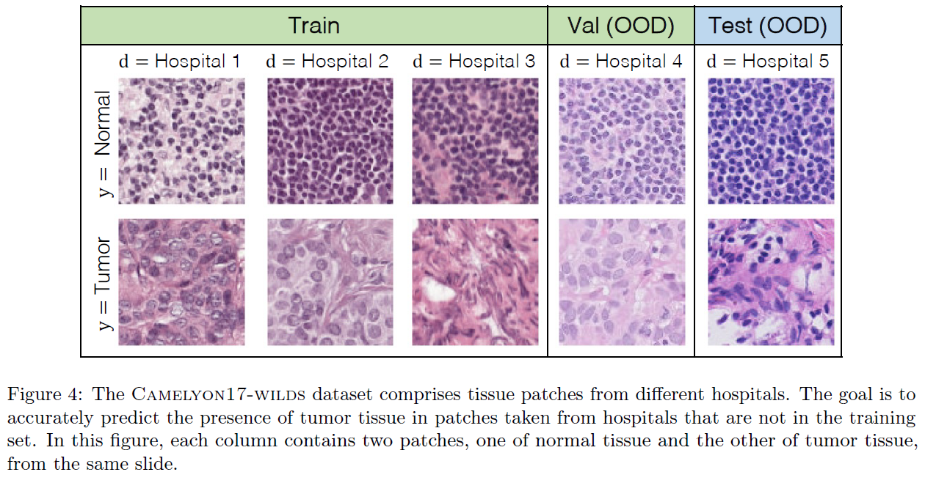
One example: domain shift and domain generalization
Koh, Pang Wei, et al. "Wilds: A benchmark of in-the-wild distribution shifts." International Conference on Machine Learning. PMLR, 2021.

Slide 6
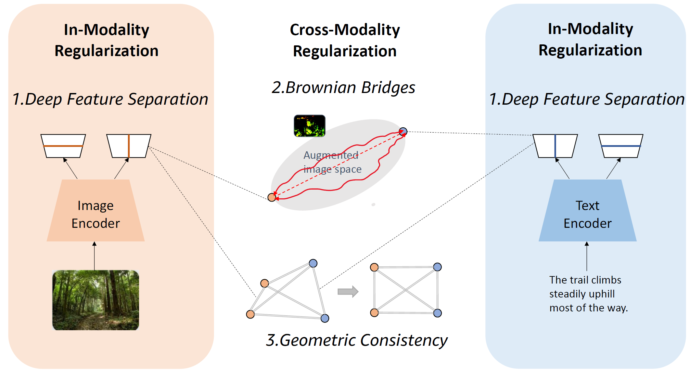
Another example, self-supervised learning, pretraining, ….
Jiang, Qian, et al. "Understanding and constructing latent modality structures in multi-modal representation learning." 2023 CVPR.

Slide 7
Inspiration towards the challenge
Analyzing and understanding the extracted features or representations are essential towards decent performance for applications.
Today, probe the challenge under the OSR concept.

Slide 8
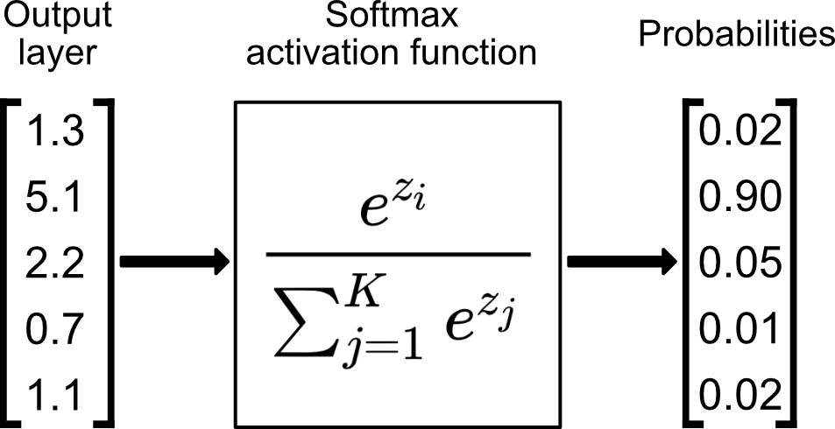
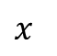
Background
Logit
Image
Feature
extractor
Feature
$x$
Strategies to detect unknown:
Probability space, such as maximal probability.
Logit space, such as maximal logit.

Slide 9
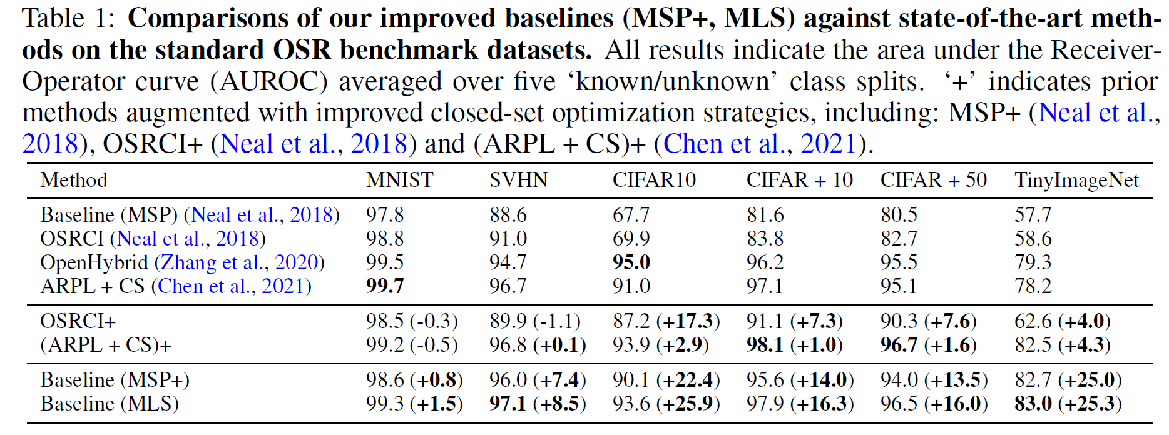
An empirical observation: maximal logit is superior to maximal probability in AUROC.
Is there any reason behind the observation?
Logit
2022 ICLR Open-Set Recognition A Good Closed-Set Classifier is All You Need.

Slide 10

Notations
Given a training dataset $𝒟_{tr}={\left\{\left(x_{k,i},k\right)\right\}}_{i=1}^{N}$, with $N$ training samples and $K$ classes from distribution $𝒫_{tr}$.
Given the data $x_{k,i}$ belonging to class $k$, $i$ is sample index.
Last layer features $h_{k,i}$.
Logit $z_{k,i}=W_{L}h_{k,i}$, $W_{L}=[w_{1},w_{2},…,w_{K}]$.
Logit
Feature

Slide 11
Official formularization of OSR
Training:
Only known images are given.
Loss objective: train a network with high accuracy on the known dataset.
Test:
Known and known
Application objective: distinguish unknown classes from known classes and obtain high accuracy in known.

Slide 12
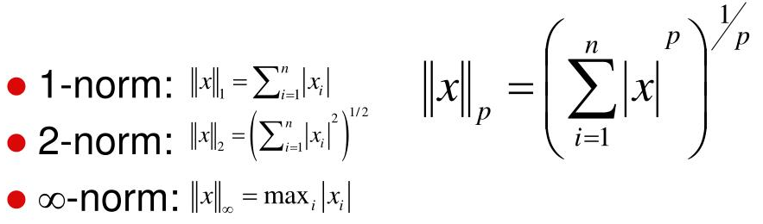
Analysis for MaxLogit and MaxSoftmaxProb (MSP)
Monotonic function does not change the OSR performance.
Therefore, the only difference between them is the summation.
The summation is essentially the feature norm (Feature’s scale).

Slide 13
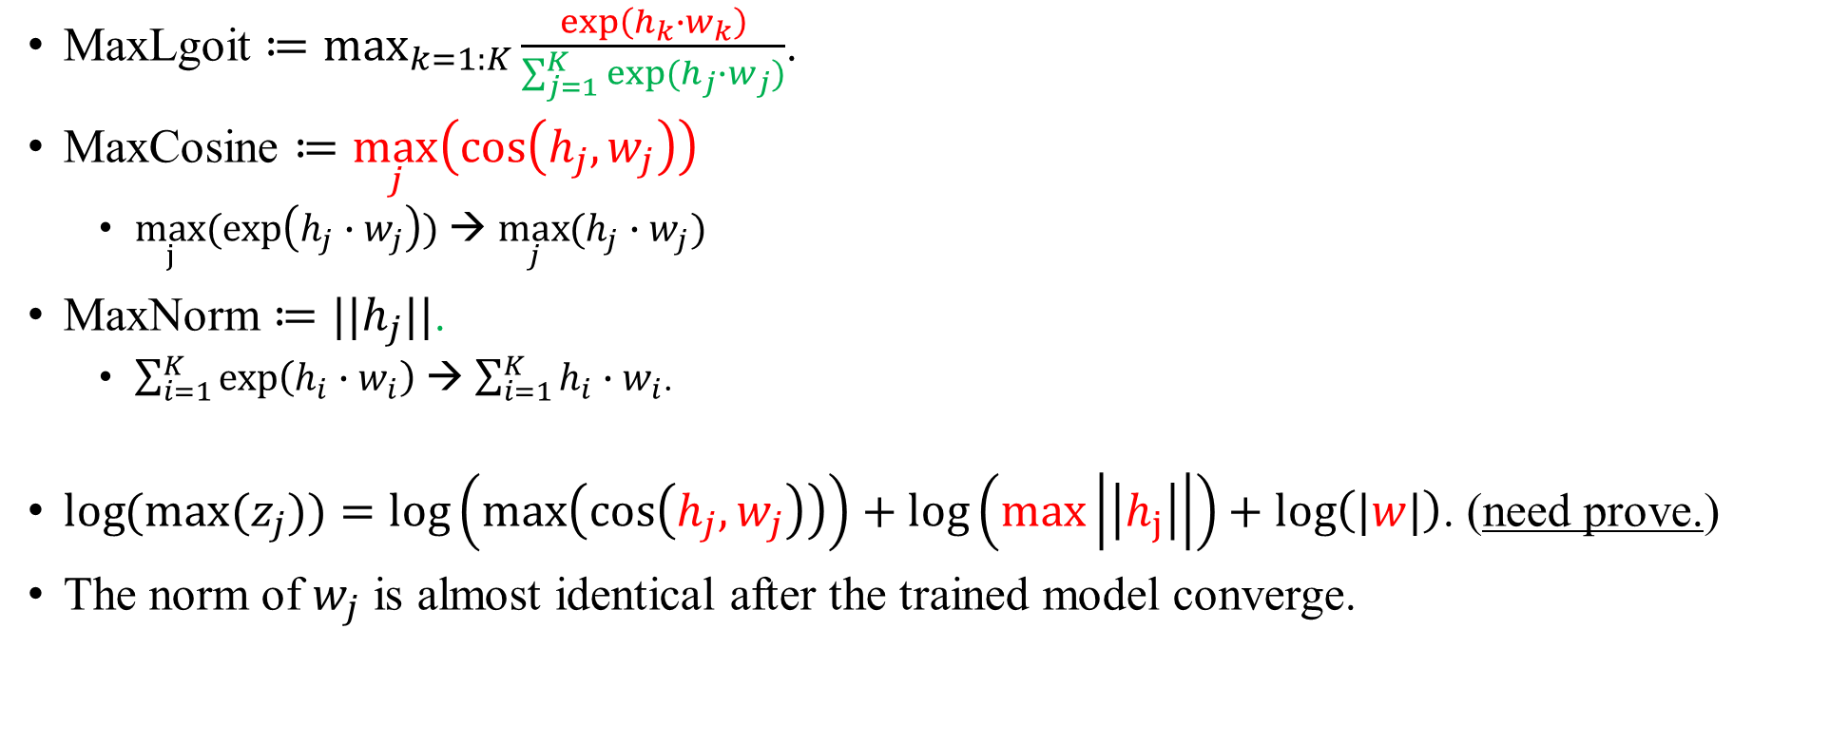
Decouple MaxLogit
MaxLgoit $≔\max_{k=1:K}{\frac{\exp\left(h_{k}{∙w}_{k}\right)}{\sum_{j=1}^{K}{exp⁡(h_{j}∙w_{j})}}}$.
MaxCosine $≔\max_{j}\left(\cos\left(h_{j},w_{j}\right)\right)$
$\max_{j}(\exp\left(h_{j}∙w_{j}\right))$ → $\max_{j}{(h_{j}∙w_{j})}$
MaxNorm $≔||h_{j}||\text{.}$
$\sum_{i=1}^{K}{\exp\left(h_{i}∙w_{i}\right)}$ → $\sum_{i=1}^{K}{h_{i}}∙w_{i}$.
$\log{(\max{(z_{j})})}=log\left(max\left(\cos\left(h_{j},w_{j}\right)\right)\right)+log\left(max\left|\left|h_{j}\right|\right|\right)+log\left(|w|\right)$. (need prove.)
The norm of $w_{j}$ is almost identical after the trained model converge.

Slide 14
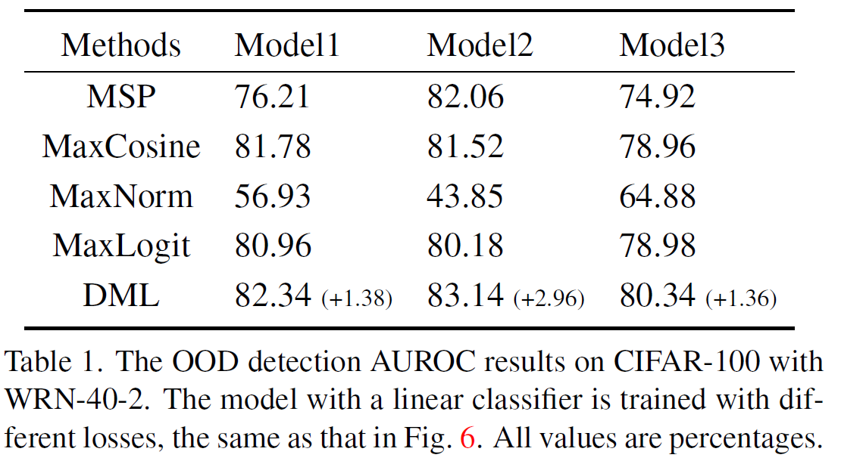
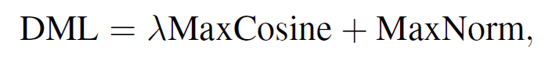
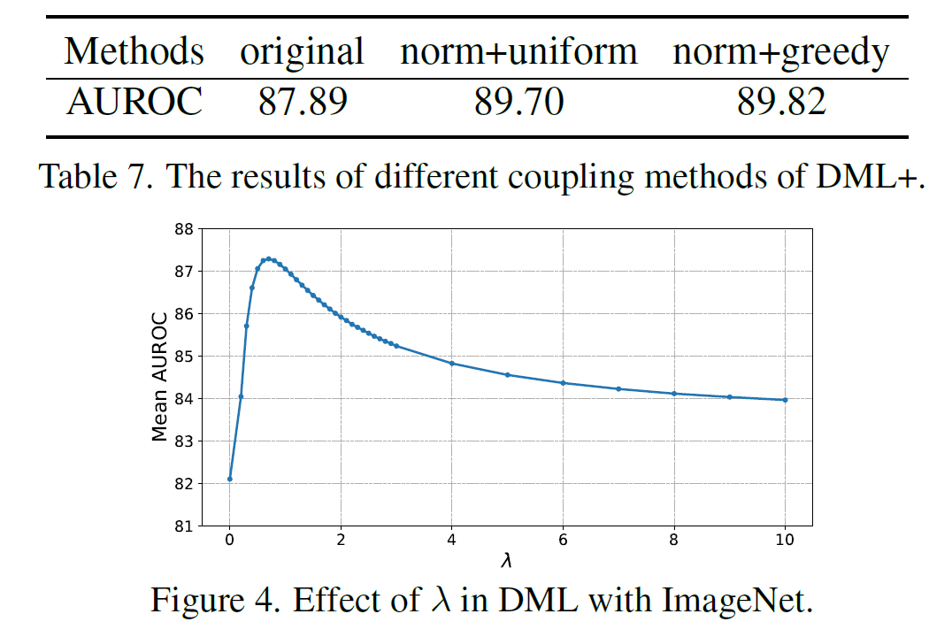
Empirical observation
MaxCosine is better than MaxLogit in different models. MaxNorm is worse than MaxLogit.
We can say that MaxLogit dragged down by MaxNorm. (why?)
The gap between MaxNorm and MaxCosine seems contributing more to MaxLogit. → MaxNorm may be complementary to MaxCosine.
So, DML (decoupling MaxLogit)

Slide 15
Break
DML is NOT the end.
Can we use any method to improve the MaxCosine and MaxNorm.

Slide 16
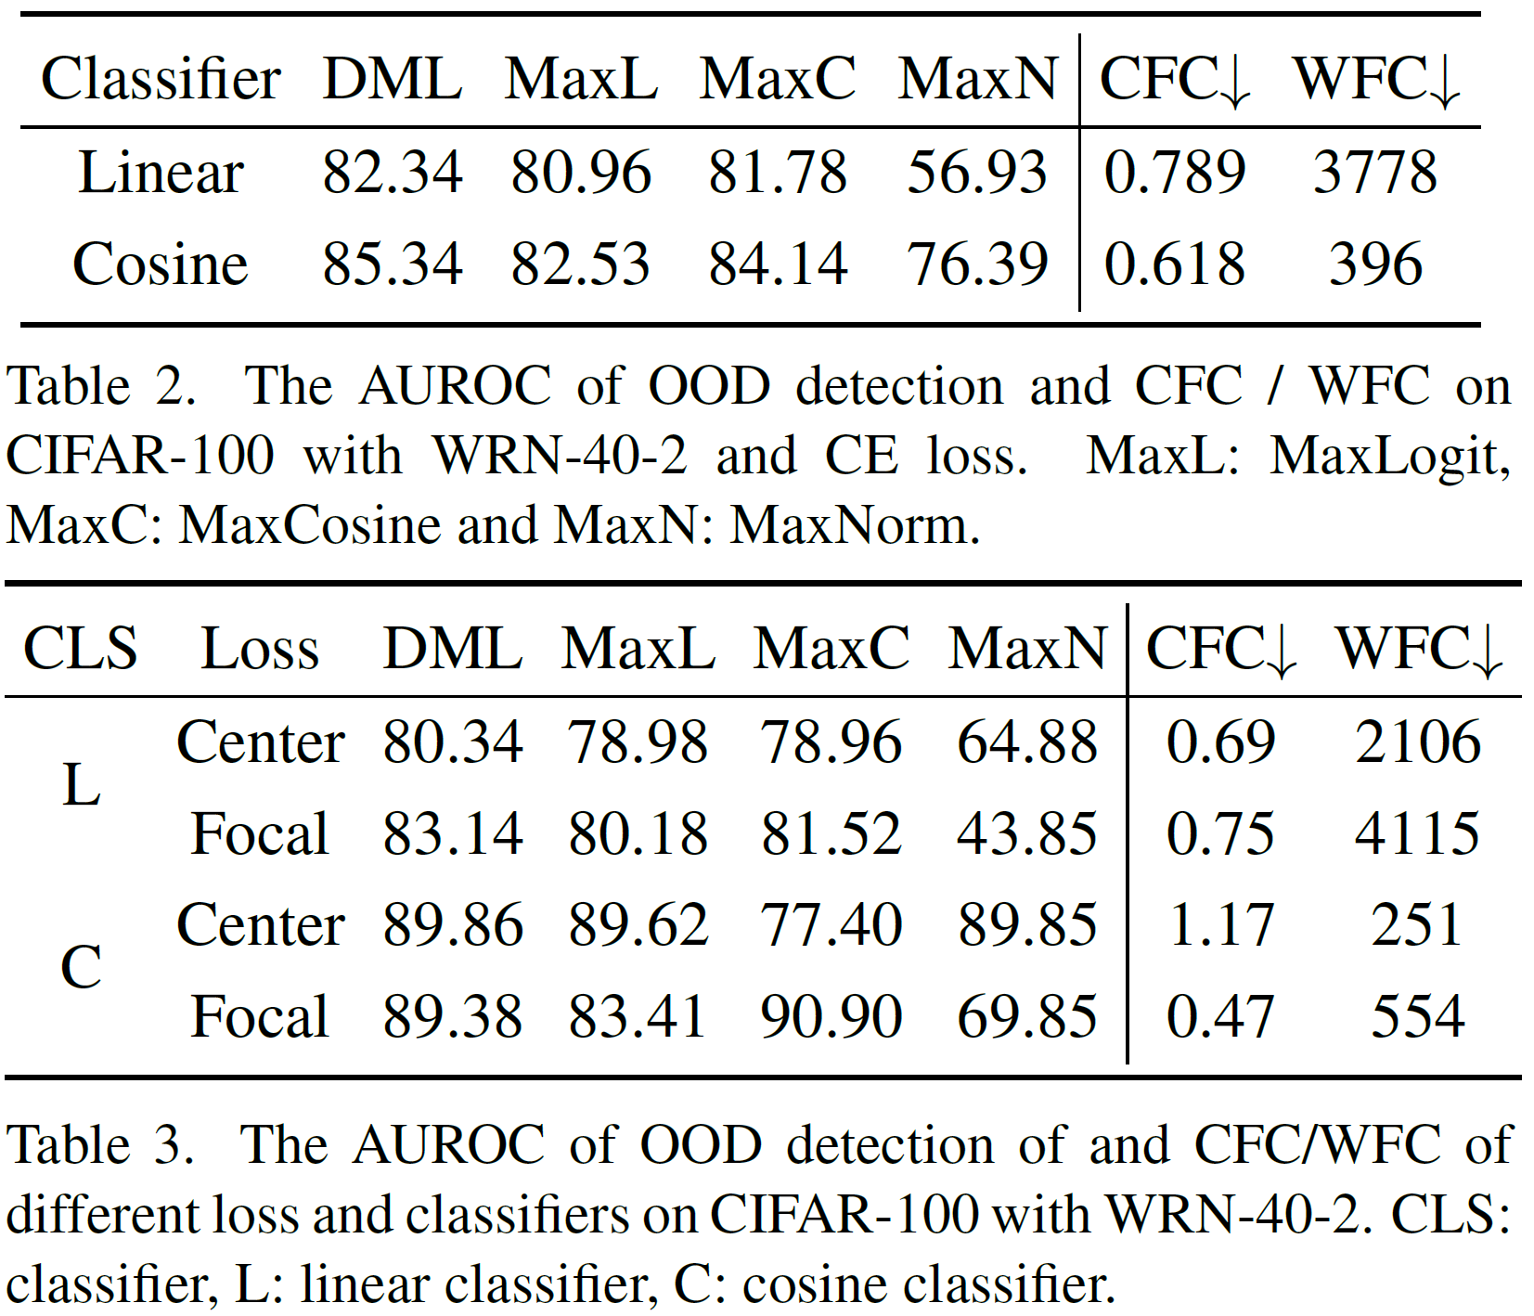
Cosine classifier may lead to better MaxCosine and MaxNorm, and other logit-based method. The cosine classifier optimizes the cosine similarity in the training process.

Slide 17
Is there any other method to optimize the cosine similarity and feature norm directly?

Slide 18
A background, feature collapse
Definition:
1) Class means and the weight of last-layer of classifier all collapse to the vertices.
2) the feature variability of within-class cross-examples collapse to zero.
Within-class samples have no difference in the feature space.
Feature collapse is not good sometimes, for example, knowledge distilling.
Zhu, Zhihui, et al. "A geometric analysis of neural collapse with unconstrained features." NIPS 2021.

Slide 19
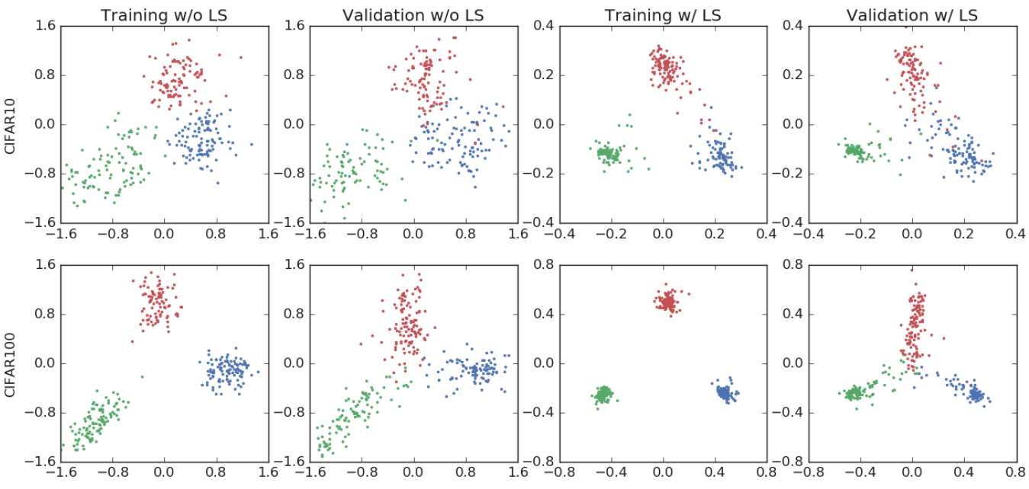

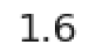
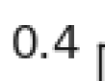
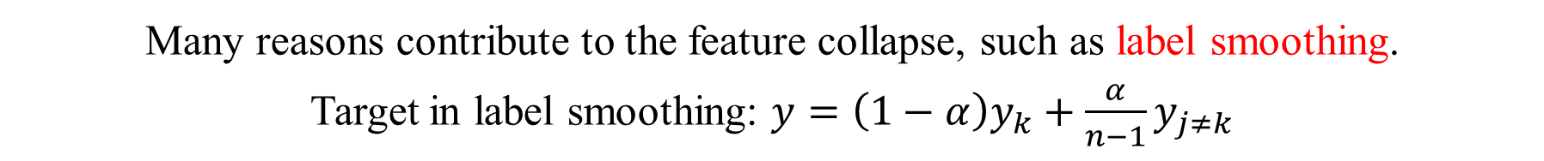
Many reasons contribute to the feature collapse, such as label smoothing.
Target in label smoothing: $y=\left(1−α\right)y_{k}+\frac{α}{n−1}y_{j≠k}$
Müller, Rafael, Simon Kornblith, and Geoffrey E. Hinton. "When does label smoothing help?." NIPS 2019.

Slide 20
Label smoothing degrades face recognition with cosine similarity
Many reasons contribute to the feature collapse, such as label smoothing.
Target in label smoothing: $y=\left(1−α\right)y_{k}+\frac{α}{n−1}y_{j≠k}$
Müller, Rafael, Simon Kornblith, and Geoffrey E. Hinton. "When does label smoothing help?." NIPS 2019.

Slide 21
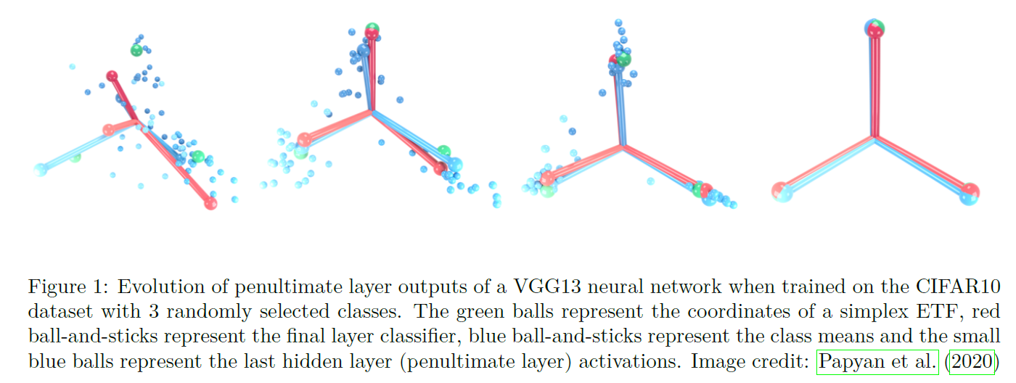
Neural collapse
Layer classifier, class means, activations are in close points.
"Neural Collapse: A Review on Modelling Principles and Generalization." Transactions on Machine Learning Research (2023).

Slide 22
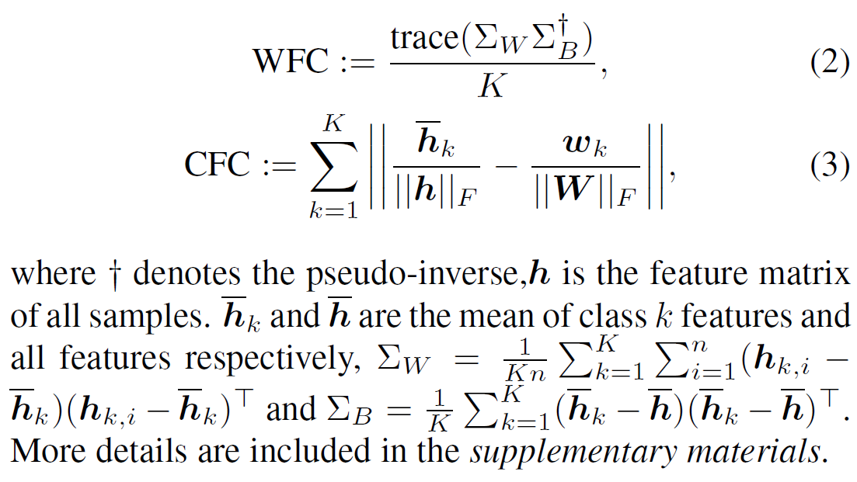
Metrics to check the feature collapse
WFC: within-class feature convergence, combination of average within-class feature variance and their mean variance.
CFC: class mean feature convergence to the corresponding classifier.
Smaller → more collapse.
Zhu, Zhihui, et al. "A geometric analysis of neural collapse with unconstrained features." NIPS 2021.

Slide 23
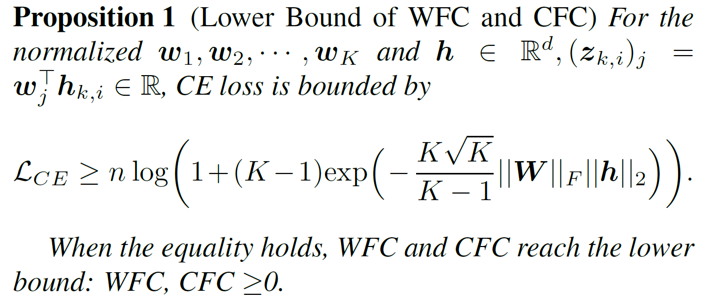
OOD detection benefits from decreasing WFC and CFC.
Why is reducing cross entropy loss in the training dataset better for detection OOD?
Is there any elusive assumption behind?

Slide 24
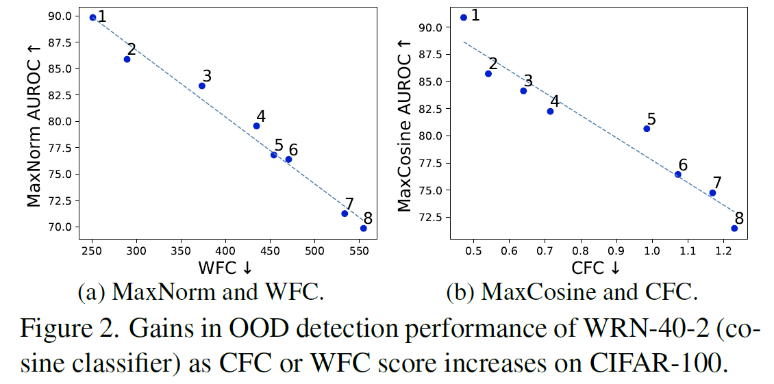
Lower WFC leads to better MaxNorm
Lower WFC, more compact features, better MaxNorm.
Smaller CFC, closer feature from the classifier, better MaxCosine.

Slide 25
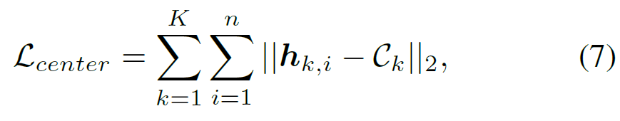
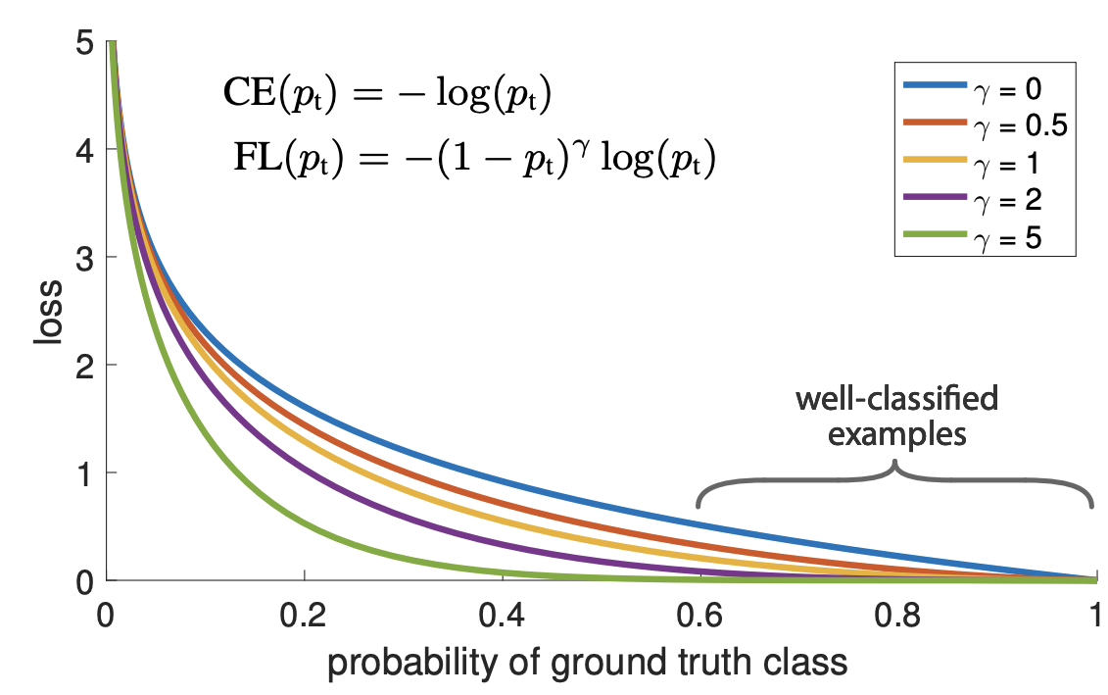
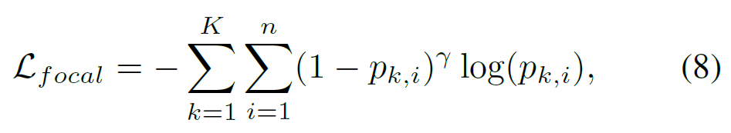
Using more loss functions
Center loss for compact feature space, and thus lower WFC, and thus superior AUROC.
Focal loss gives bigger loss for the features in the low-likelihood region (hard examples), and thus pushes the features towards the classifier weight, and further lower CFC.

Slide 26
MaxCosine and MaxNorm achieve better with center loss and focal loss, differently.

Slide 27

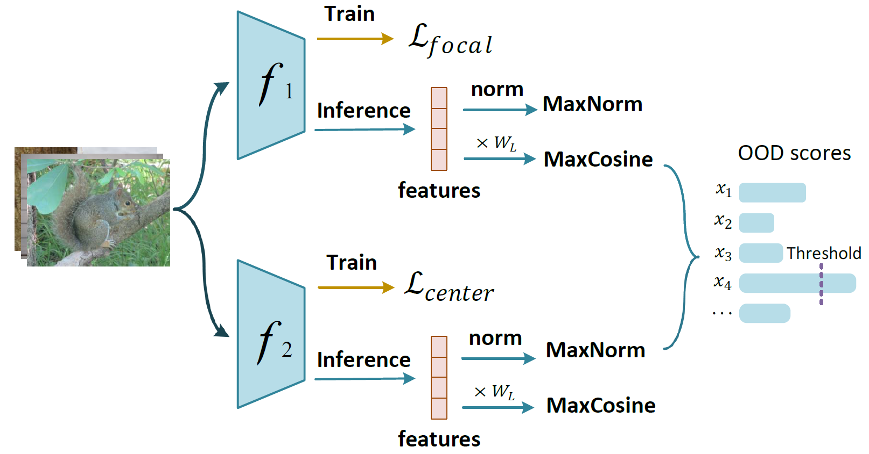
Ultimate idea: decoupling MaxLogit + (DML+)
MaxCosine from focal loss and MaxNorm from central loss.

Slide 28
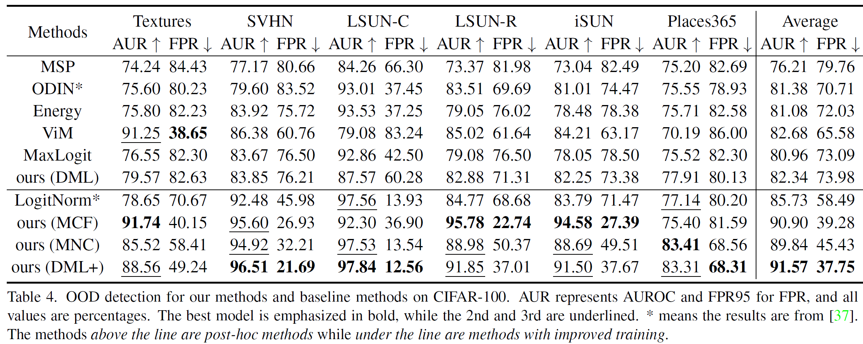
Holistic performance, training in CIFAR-100
MaxCosineFocal, MaxNormCenter. Why is not the best DML+, such as Textures? They are declared complementary. The natural difference between known and unknown?

Slide 29
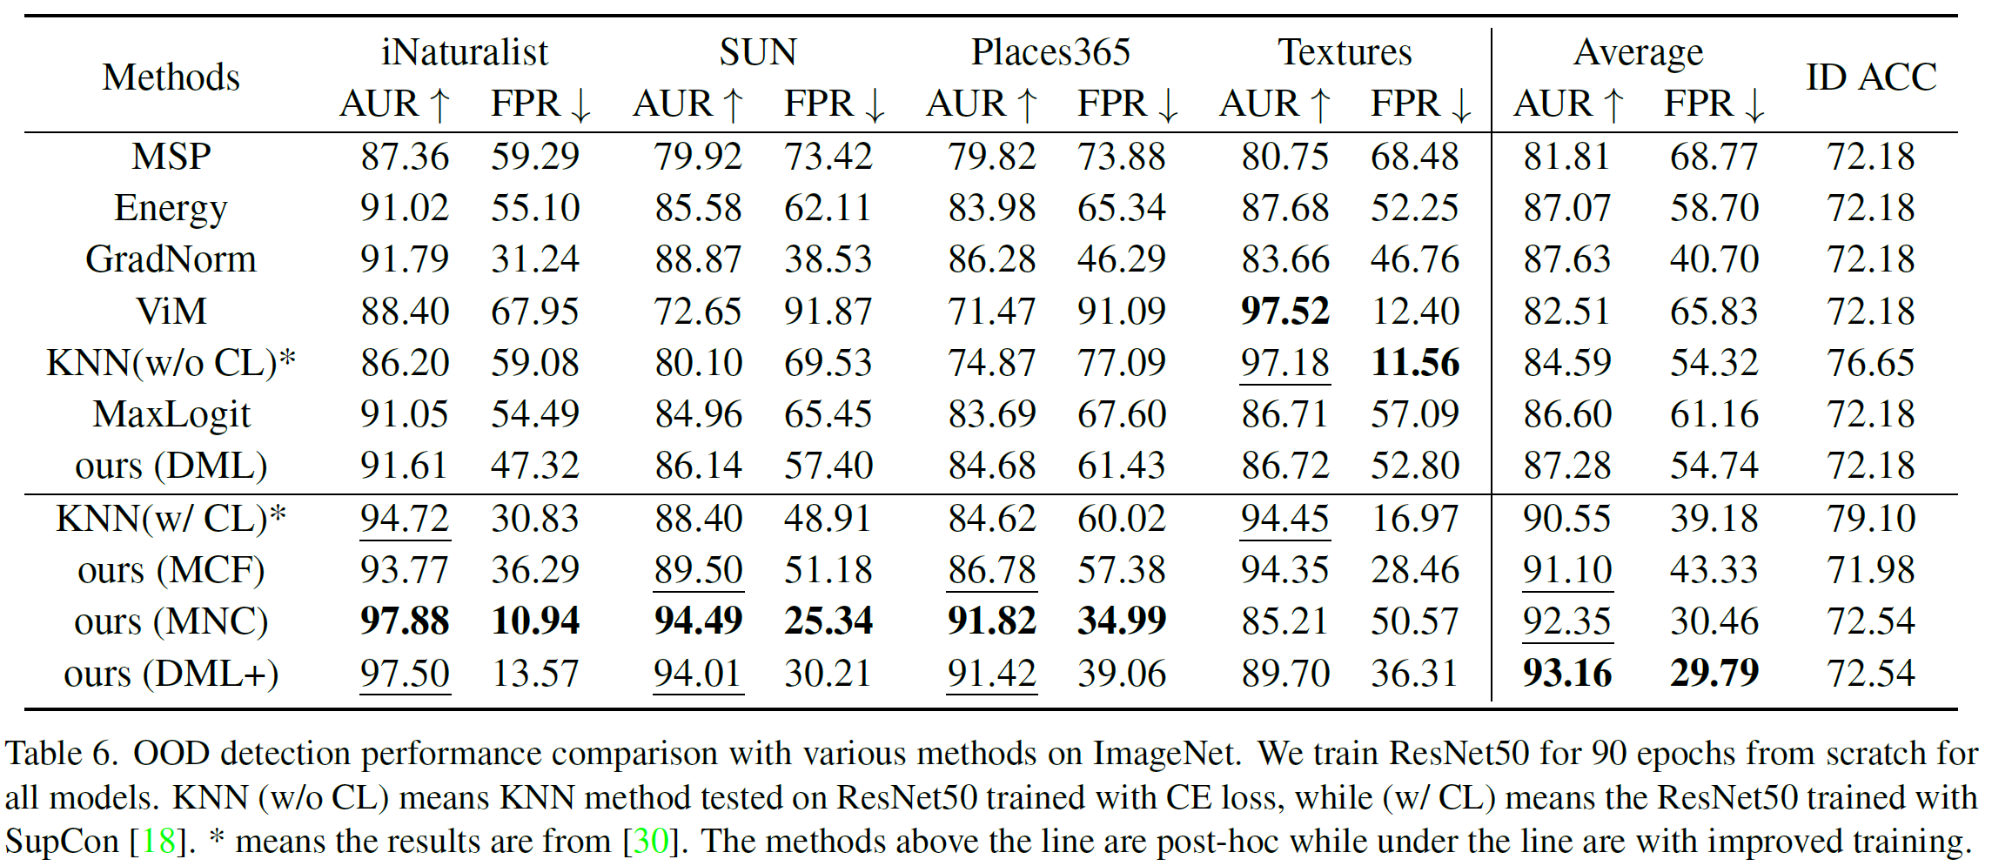
Training with ImageNet-1k.
OOD and ID may suffer from similar feature norm in textures.

Slide 30
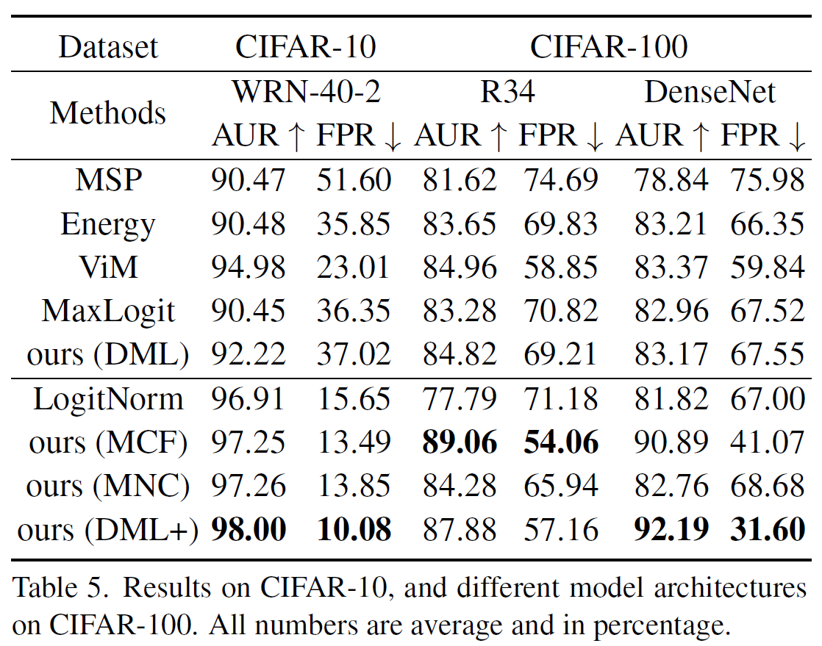
Ablation study
Model architectures is also a factor.

Slide 31
Ablation study

Slide 32
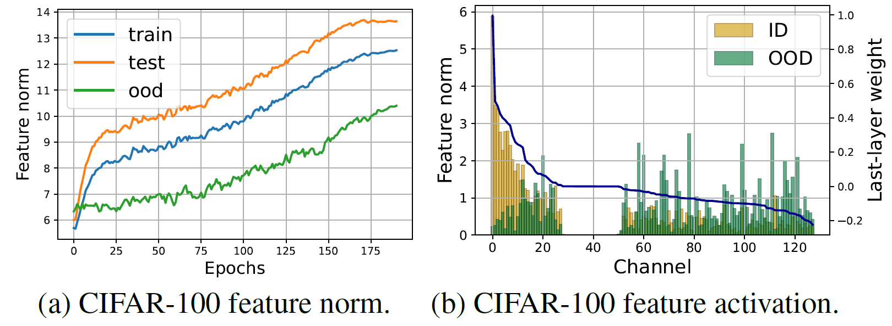
Visualization of the feature norm
Why the feature norm of OOD is increasing? The trained model extracts the features from OOD. (Familiarity hypothesis)
"The familiarity hypothesis: Explaining the behavior of deep open set methods." Pattern Recognition 132 (2022): 108931.

Slide 33
Discussion
Closed-set and open-set performance are strongly correlated?
MCF and MNC model take similar training costs as the baseline and achieve similar ID accuracy. But the OOD detection performance is much higher than the baseline.

Slide 34
Conclusion
Using feature norm and cosine similarity is not new, but it is connected with the empirical observation (below).
Start from an observation: MaxLogit is superior to MaxSoftmaxProbability.
Analyze the difference and found the factors.
Further, using regularizations to facilitate the OSR.
Use ensemble to contribute more.
The comparison is a little less.
The performance is not that kind of good.

